Slide 1
Memories

Slide 2
Random Access Memory (RAM)
It is also called read-write memory or the main memory or the primary memory.
The programs and data that the CPU requires during the execution of a program are stored in this memory.
It is a volatile memory as the data is lost when the power is turned off.

Slide 3
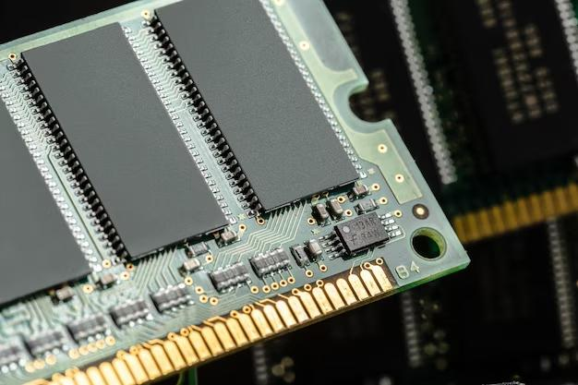

Slide 4
Types of Random Access Memory (RAM)
Static RAM (SRAM)
Dynamic RAM (DRAM)
1. Static RAM: SRAM stands for Static Random Access Memory. It is a type of semiconductor which is widely used in computing devices and microprocessors.
2. Dynamic RAM: DRAM stands for Dynamic Random Access Memory. It is made of Capacitors and has smaller data life span than Static RAM.

Slide 5
SRAM
SRAM stands for Static Random Access Memory. It is a form of a semiconductor. It is widely used in microprocessors, general computing applications and electronic devices. The SRAM is volatile in nature that means the data stored in it gets all wiped out once the power supply is cut. SRAM comprised of flip flops. It consist of 4-6 transistors, once the flip flop stores the bit it keep it stored until the opposite bit is stored in it.

Slide 6
Characteristics
The data is held statically: The data is stored statically in SRAM and it doesn’t need to be refreshed unlike DRAMs.
It is a type of Random Access Memory: The SRAM is a type of Random Access Memory. Random Access Memories are those from which the data can be accessed (read/write) randomly (means any memory location can be accessed), regardless of the memory location that was accessed earlier.
It uses flip flop for storing data: It uses flip flops to store bits. Each flip flop is made up of 4-6 transistors.
It is used as a Cache Memory in CPU: SRAM is used as cache memory for CPUs as they are faster and stores data statically.
Advantages

Slide 7
Advantages
It is faster to access and perform operations like read & write.
The data can be accessed randomly.
It is used as a cache memory.
It doesn’t need to be refreshed as it stored data statically.
It has medium power consumption. It requires less power as compared to DRAM

Slide 8
Disadvantages
It is expensive.
It is volatile in nature i.e., data is lost when the memory is not powered.
It has a low storage capacity.
It is not possible to refresh the program.
It has a more complex design and they are bigger in size as well when compared to DRAM.
It reduces the memory density.

Slide 9
DRAM
DRAM stands for Dynamic Random Access Memory A type of random access memory that stores each bit(0 or 1) of data in a memory cell, these memory cells consist of two devices, a tiny capacitor, and a transistor, both are based on (MOS) technology.

Slide 10
The word “Dynamic” used because DRAM changes its state from 0 to 1 over a period of time, due to the slow leakage of charge from the capacitor. To prevent this, DRAM requires an external memory refresh, which rewrites the data int the capacitors, restoring them to their original charge. DRAM typically consist of dozens to billions of DRAM memory cells.

Slide 11
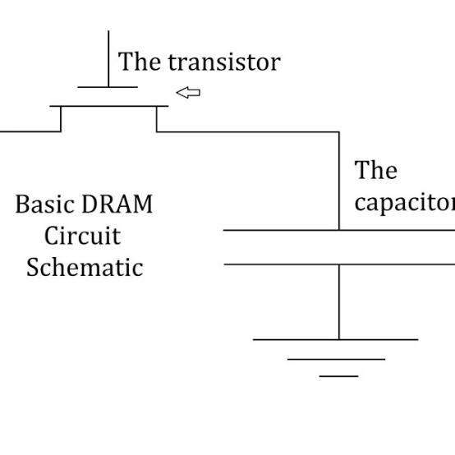

Slide 12
Characteristics of DRAM
It has short data lifetime.
It is less expensive.
It is smaller in size.
It is slower as compared to SRAM.
less power consumption.

Slide 13
Advantage of DRAM
DRAM memory can be deleted and refreshed while running the program.
It is Cheaper as compare to SRAM.
It has higher storage capacity. Hence it is used to create larger RAM space system.
It is simple in structure than SRAM.

Slide 14
Disadvantage of DRAM
It is comparatively slower than SRAM. Hence it takes more time for accessing data or information.
It loses data when power is OFF.
It has higher power consumption compare to SRAM

Slide 15
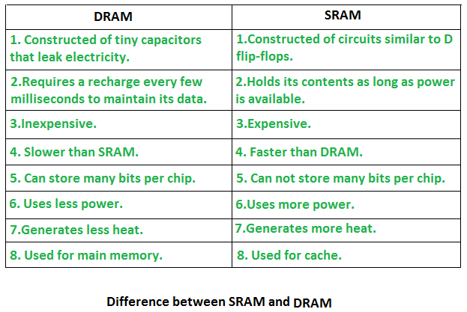

Slide 16
Advantages of Random Access Memory (RAM)
Speed: RAM is much faster than other types of storage, such as a hard drive or solid-state drive, which means that the computer can access the data stored in RAM more quickly.
Flexibility: RAM is volatile memory, which means that the data stored in it can be easily modified or deleted. This makes it ideal for storing data that the computer is currently using or processing.
Capacity: The capacity of RAM can be easily upgraded, which allows the computer to store more data in memory and thus improve performance.
Power Management: RAM consumes less power compared to hard drives, and solid-state drives, which makes it an ideal memory for portable devices.

Slide 17
Disadvantages of Random Access Memory (RAM)
Volatility: RAM is volatile memory, which means that the data stored in it is lost when the power is turned off. This can be a problem for important data that needs to be preserved, such as unsaved work or files that have not been backed up.
Capacity: The capacity of RAM is limited, and although it can be upgraded, it may still not be sufficient for certain applications or tasks that require a lot of memory.
Cost: RAM can be relatively expensive compared to other types of memory, such as hard drives or solid-state drives, which can make upgrading the memory of a computer or device more costly.

Slide 18
Read-Only Memory (ROM)
Stores crucial information essential to operate the system, like the program essential to boot the computer.
It is non-volatile.
Always retains its data.
Used in embedded systems or where the programming needs no change.
Used in calculators and peripheral devices.
ROM is further classified into four types- MROM, PROM, EPROM, and EEPROM.

Slide 19
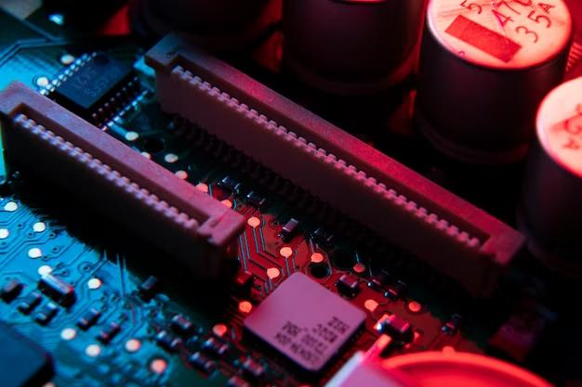

Slide 20
Types of Read-Only Memory (ROM)
PROM (Programmable Read-Only Memory)
EPROM (Erasable Programmable Read Only Memory)
EEPROM (Electrically Erasable Programmable Read Only Memory)
MROM (Mask Read Only Memory)

Slide 21
1. PROM (Programmable read-only memory): It can be programmed by the user. Once programmed, the data and instructions in it cannot be changed.
2. EPROM (Erasable Programmable read-only memory): It can be reprogrammed. To erase data from it, expose it to ultraviolet light. To reprogram it, erase all the previous data.
3. EEPROM (Electrically erasable programmable read-only memory): The data can be erased by applying an electric field, with no need for ultraviolet light. We can erase only portions of the chip.
4. MROM(Mask ROM): Mask ROM is a kind of read-only memory, that is masked off at the time of production. Like other types of ROM, mask ROM cannot enable the user to change the data stored in it. If it can, the process would be difficult or slow.

Slide 22
PROM
PROM stands for Programmable Read-Only Memory
It is a memory chip on which information can be composed as it were once. Once a program has been composed onto a PROM, it remains there until the end of time. Not at all like Ram, PROMs hold their substance when the computer is turned off. A PROM is fabricated as blank memory, and after that, an uncommon burner is utilized to compose to it once. PROMS ordinarily store low-level gadget drivers for particular equipment and are burned once.

Slide 23
A programmable read-only memory may be a frame of advanced memory where the setting of each bit is bolted by a meld or anti-fuse. It is one sort of ROM. The information in them is changeless and cannot be changed. PROM could be a sort of ROM that’s modified after the memory is built. PROM chips have a few diverse applications, counting cell phones, video amusement supports, RFID labels, restorative gadgets, and other gadgets. They give a straightforward implies of programming electronic gadgets

Slide 24
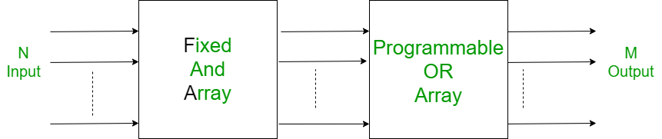
Block Diagram

Slide 25
Applications of PROM
Mobile Phones for giving Client Particular Selections.
Implantable Restorative devices.
Radio-Frequency Identification (RFID)tags.
High definition Multimedia Interfaces(HDMI)

Slide 26
Characteristics of PROM
It has programmable random access memory
In prom And gates are fixed and or gates are programmable
Prom Works as a memory
It is not reusable.
The storage endurance of PROM is high
few functions can be actualized(it is effective when the work to be implemented(i.e the min terms) must have all the variables.

Slide 27
Advantages of PROM
The programming can be done utilizing numerous sorts of program and does not depend on difficult wiring of the program to the chip.
Since it isn’t conceivable to un-blow the intertwine, so the realness of the information remains intaglio and it is outlandish to evacuate or modify the substance.
Disadvantages of PROM
PROM is that the data once burnt cannot be deleted or changed when recognized with errors.

Slide 28
EPROM
EPROM stands for Erasable Programmable Read-Only Memory. It is a memory chip that is non-volatile in nature that is it can hold the data even after the power supply is stopped. It can be reused again and again as it is easily programmable and erasable.

Slide 29
In 1967, Dawon Kahng and Simon Sze at Bell Labs proposed that the floating gate of a MOSFET(metal-oxide-semiconductor field-effect transistor) could be used for the cell of a reprogrammable ROM (read-only memory). With this concept in mind, Dov Frohman of Intel invented EPROM in 1971. Frohman designed the Intel 1702, a 2048-bit EPROM, which was announced by Intel in 1971.

Slide 30
Characteristics
Each and every EPROM is programmed by electronic devices.
The data contained in EPROM is erased by exposing it to ultraviolet light.
EPROM can store data minimum for 10-20 years.
Erasing window is kept covered to avoid unwanted exposure to UV light to avoid accidental loss of data.

Slide 31
Advantages
Easily erasable and programmable.
Quite effective – As memory data can be erased again and again for use, therefore it eliminates the need of other external memory.
Disadvantages
A particular selected data is not deleted instead whole data gets erased which is the cause of worry for the user.
User needs to keep backup as whole data gets erased.
It needs UV light to erase the data which is very rare.
Process of erasing data is quite complex.

Slide 32
EEPROM
EEPROM stands for Electrically Erasable Programmable Read-Only Memory. EEPROM is a type of non-volatile primary memory and modified version of EPROM (Erasable Programmable Read-Only Memory) which uses electrical signals to erase and program the contents rather than UV signals which was used previously in EPROM. It is used as a chip in computers to store the digital data.

Slide 33
There are two types of EEPROM:
Serial EEPROM
Parallel EEPROM
History
EEPROM was developed in 1978 at Intel by George Perlegos. Being a non-volatile memory means it retains all the data even power is off and stores a large capacity of data or bits compared to EPROM. It is used as flash memories in its later version and also, to store BIOS of the computer.

Slide 34
Characteristics
Less time consuming: EEPROM takes 5-10 milliseconds to erase the content electronically unlike, EPROM takes minutes to erase the same content using UV signals.
Programmable and erasable content: It can reprogrammed n number of times and that life cycle has to be defined by the manufacture and it can be maximum of 1 million life cycles in modern EEPROMs.
No detaching of chip: To reprogram or erase the content, there is no need to take the chip out of the computer.

Slide 35
Advantages
Fast erasing of data as it uses electrical signals and can erase all contents or can erase by particular byte.
Data stored is non-volatile and retains even if the power is off.
Easy to reprogram without taking it out from computer and does not require any additional equipments for reprogramming.
Disadvantages
Data retention problem as insulator used is not a perfect insulator and manufacture provides data retention upto 10 years.
It requires different voltages for reading, writing and erasing the content.

